Slide 1
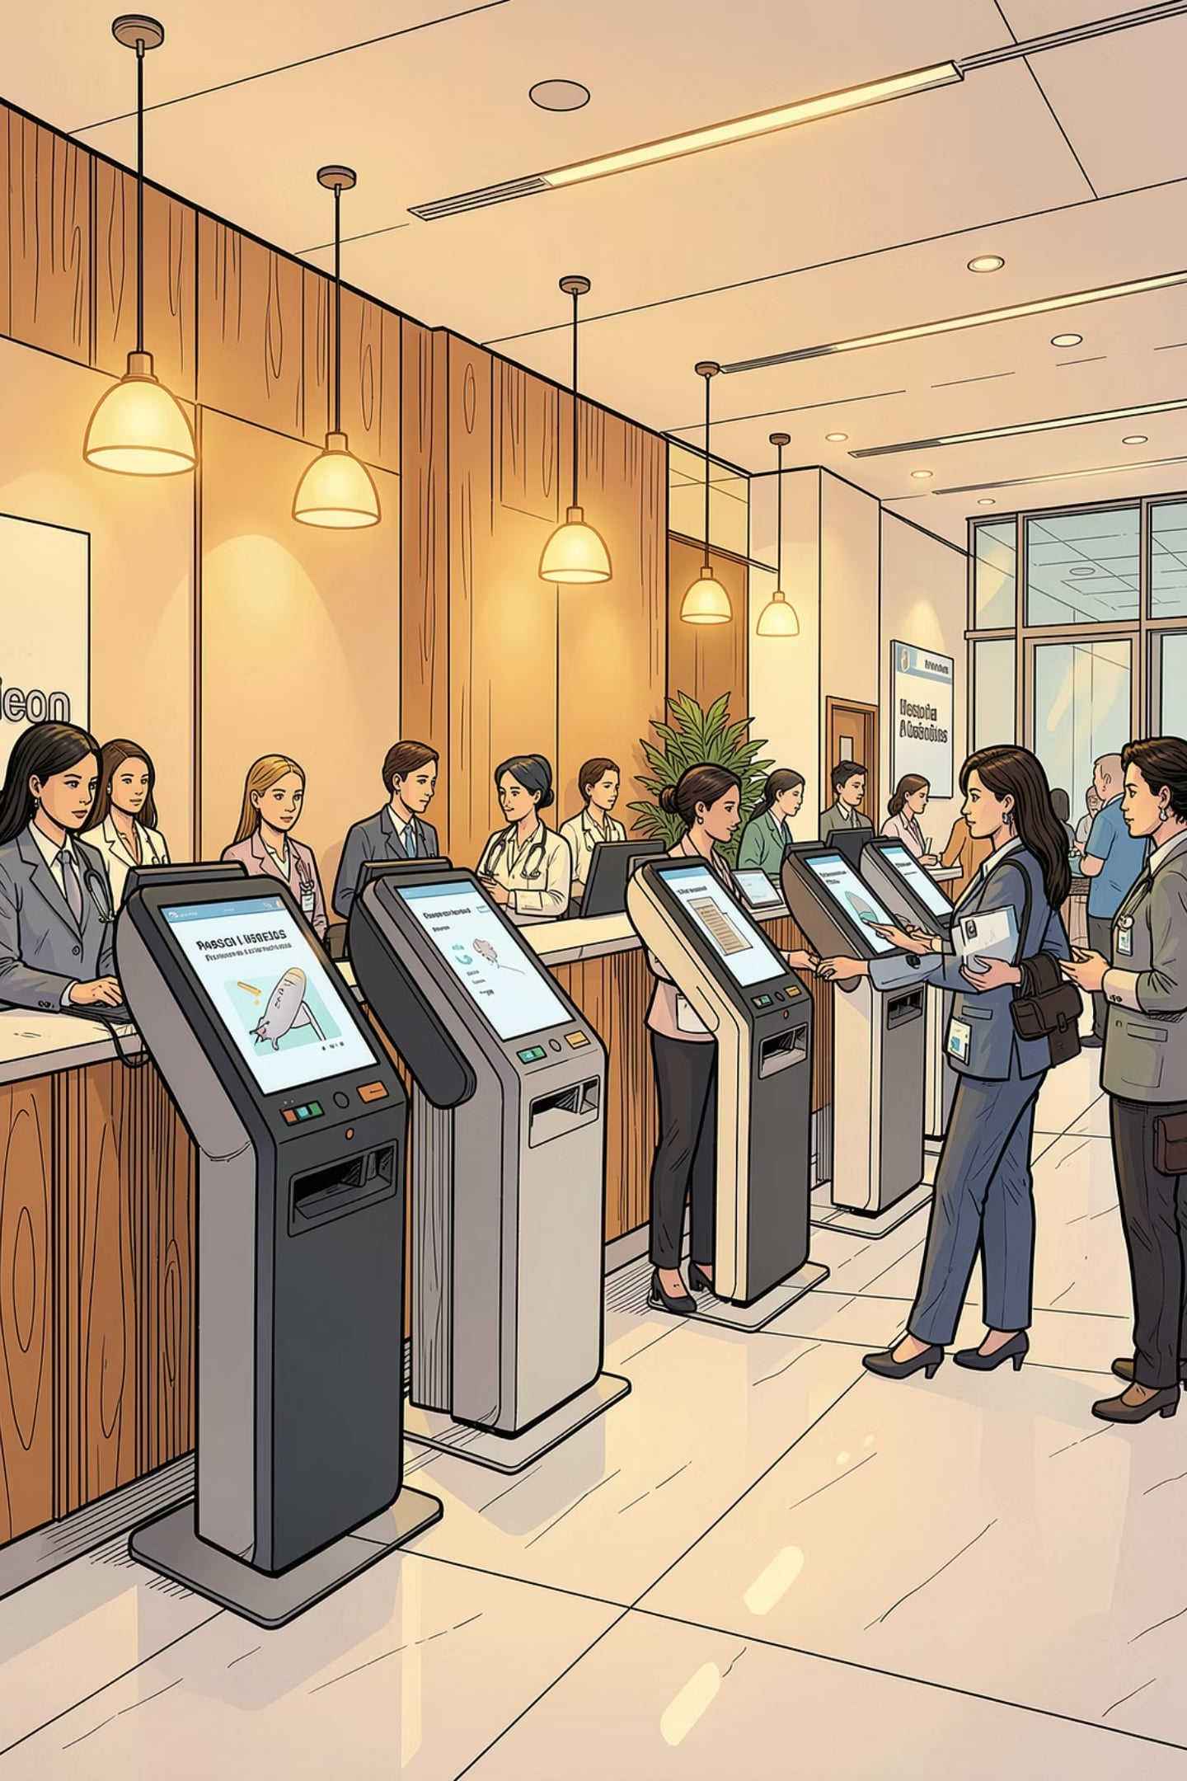

Hospital Management System
Designing a unified digital platform that streamlines clinical workflows, secures patient data, and improves operational and financial performance across the hospital.
Mr Venkateshan A MCA.,
Data Analytics

Slide 2


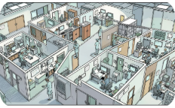

The Crisis of Paper
Inefficiency
High Error Rates
Siloed Departments
Operational Bottlenecks
Manual storage and retrieval slow care delivery and create backlog across departments.
Illegible handwriting and misplaced documents lead to medication and documentation errors.
Limited real-time communication between pharmacy, lab, and wards obstructs coordinated care.
Extended wait times and slow billing cycles reduce throughput and patient satisfaction.

Slide 3


The Core Objective: Centralized Intelligence
Capture
Enable
Digital patient intake and records
Dashboards, alerts, and clinical insights
Integrate
Connect EHR, lab, and pharmacy systems
Unified Digital Framework — Replace paper with a single, searchable repository that houses patient histories, images, and clinical notes.
Single Source of Truth — Consolidate records so clinicians have consistent, up-to-date patient data at point of care.
Clinical Accuracy & Security — Reduce medication and diagnostic errors while enforcing HIPAA-compliant controls and audit trails.

Slide 4
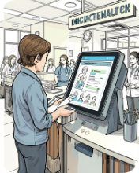
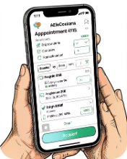
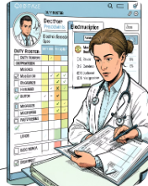
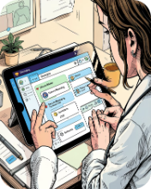
Essential Pillars: Patient & Doctor Modules
Patient Registration
Appointment Booking
Doctor Management
Communication
Seamless admission, discharge, and follow-up workflows with automatic record creation and consent tracking.
Online scheduling, automated reminders, and capacity management to reduce lobby congestion and no-shows.
Staff profiles, duty rosters, digital prescription notes, and decision support tools to speed documentation.
Integrated messaging, patient queue management, and escalation alerts for timely coordination across teams.

Slide 5
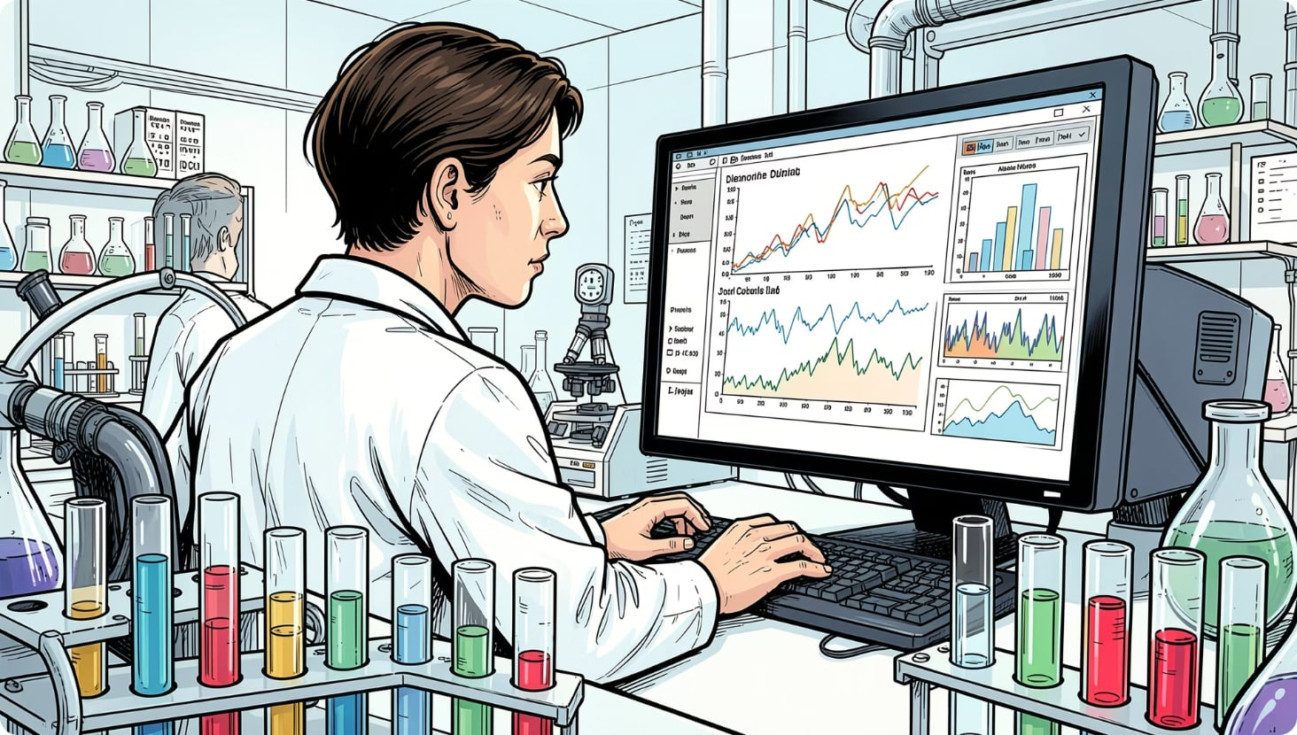
Operational Engines: Pharmacy & Laboratory
Inventory Control
Billing Integration
Automated stock tracking, reorder thresholds, and expiry management to avoid shortages and wastage.
Real-time cost calculation and itemized invoices that tie directly to services and consumables used.
Lab Management
Reporting
Electronic transmission of test orders and results directly into patient records for faster diagnosis.
Dashboards for revenue analytics, inventory KPIs, and department-level performance monitoring.

Slide 6
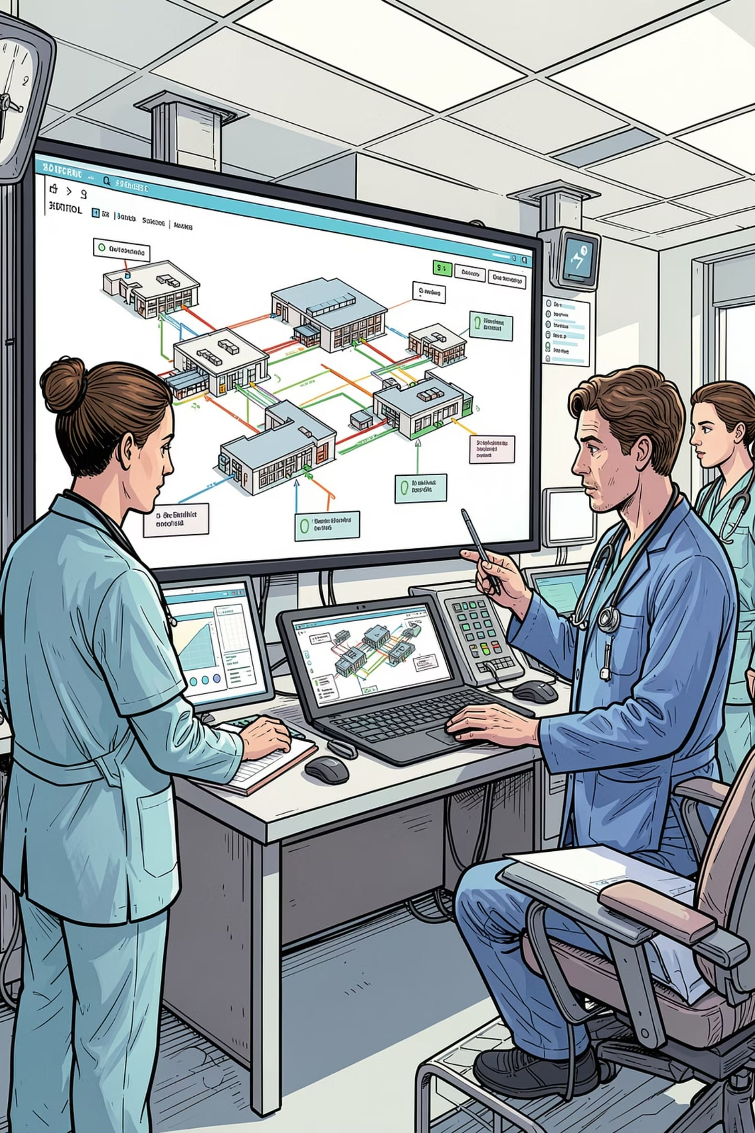
Technological Architecture
Networked Environment — Central database servers accessible via secure hospital intranet with redundancy and backups.
Accessibility — Role-based access for clinicians, nurses, and administrators with mobile and desktop clients.
Scalability — Modular microservices and cloud-ready components that expand as the facility grows.
Integration — APIs for corporate registration systems, billing gateways, imaging archives (PACS), and third-party devices.

Slide 7

The Impact: Better Outcomes, Lower Costs
Enhanced Efficiency
Automation reduces administrative paperwork dramatically, freeing staff to focus on care.
Improved Care
Immediate access to accurate history accelerates diagnosis and reduces adverse events.
Financial Health
Streamlined billing and lower resource waste increase revenue capture and cost control.
Patient Satisfaction
Shorter wait times, transparent bills, and better communication improve patient experience and trust.

Slide 8

Hospital Management System
Dashboard

Slide 9
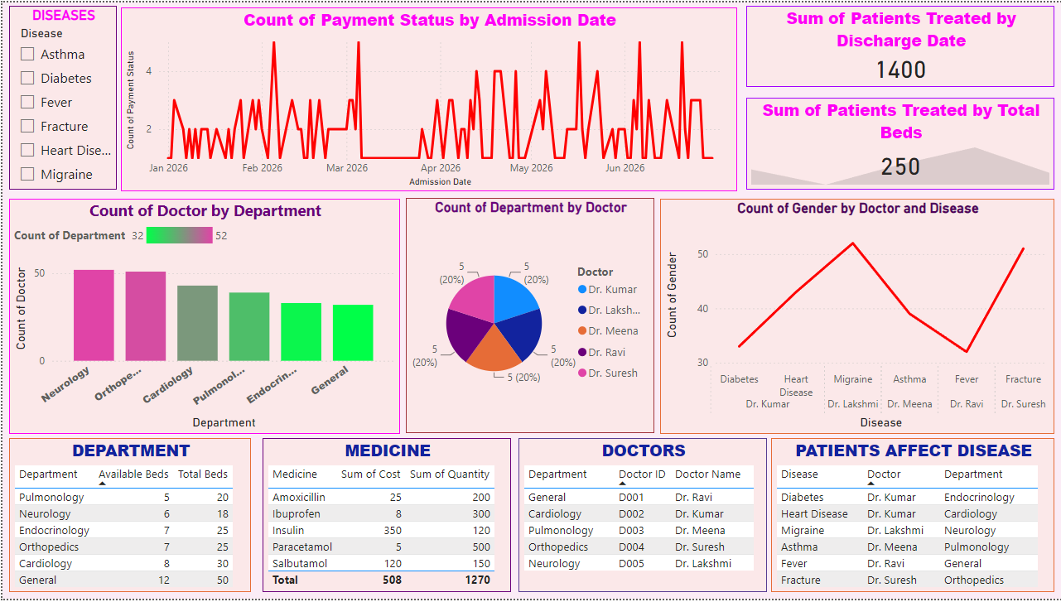
DASHBOARD

Slide 10
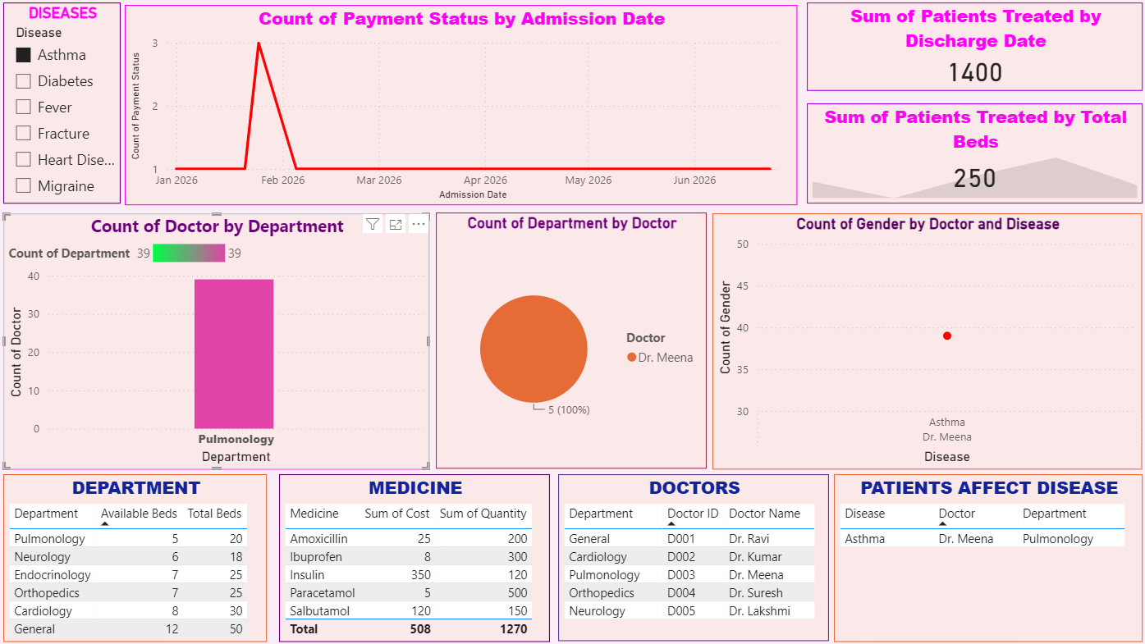

Example Diseases ‘ ASTHMA’

Slide 11


Slide 12


